Slide 1
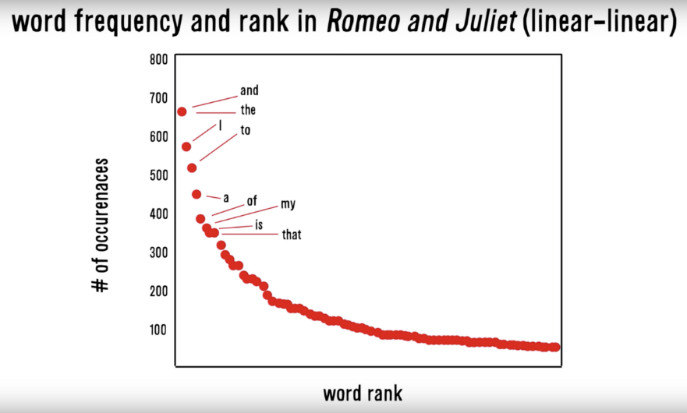
Zipf’s Law: Our words are less diverse than we think
Two very different contexts, channel, & messengers yet very similar pattern.
RT
I
Many words in natural language but also a steep decline in actual usage. Follows a predictable pattern.

Slide 2
Simple Sentiment Polarity
Scoring
Zipf’s Law
Surprise is a sentiment.
Hit by a bus! – Negative Polarity
Won the lottery!- Positive Polarity
Many words in natural language but there is steep decline in everyday usage. Follows a predictable pattern.
I loathe BestBuy Service -1
I love BestBuy Service. They are the best. +2
I like shopping at BestBuy but hate traffic. 0

Slide 3
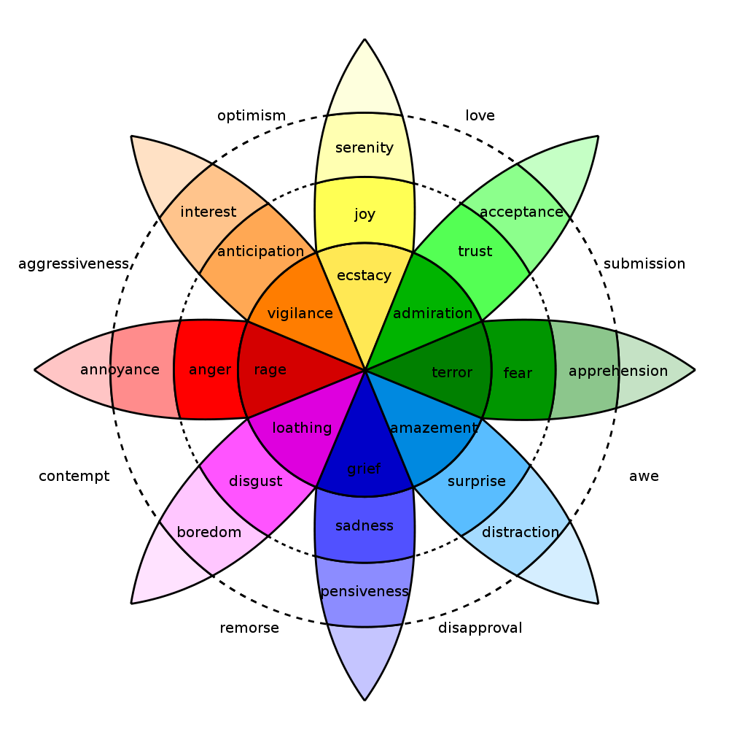
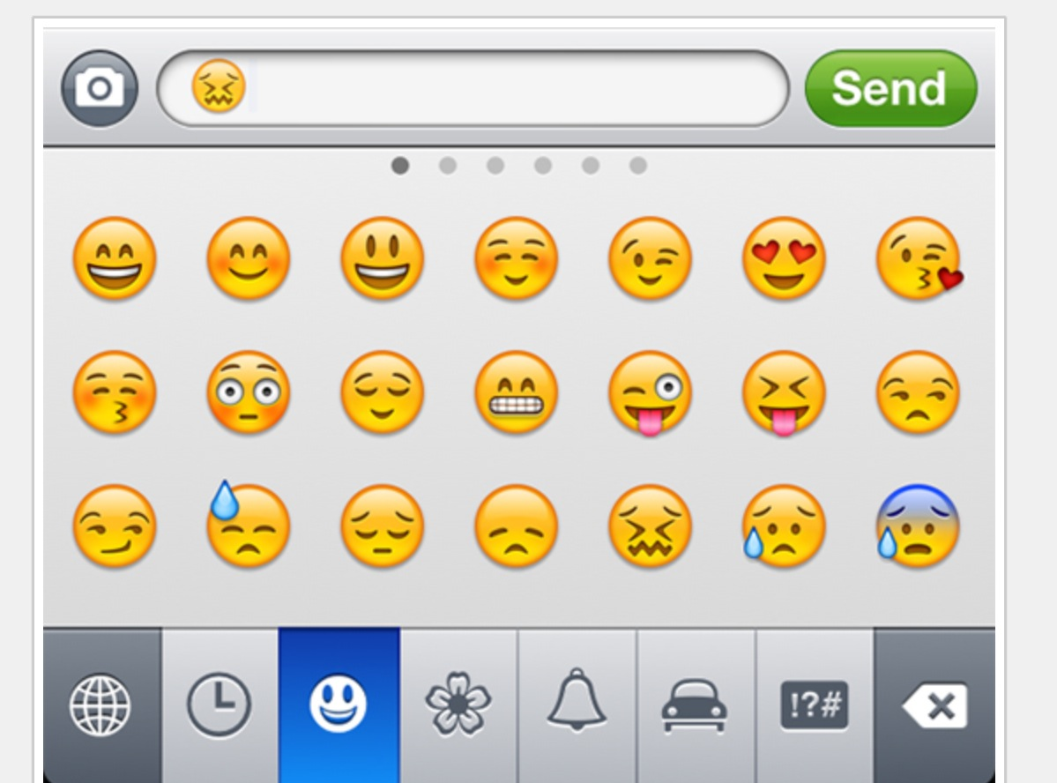
In reality sentiment is more complex.
Many Many Emoji
Plutchik’s Wheel

Slide 4
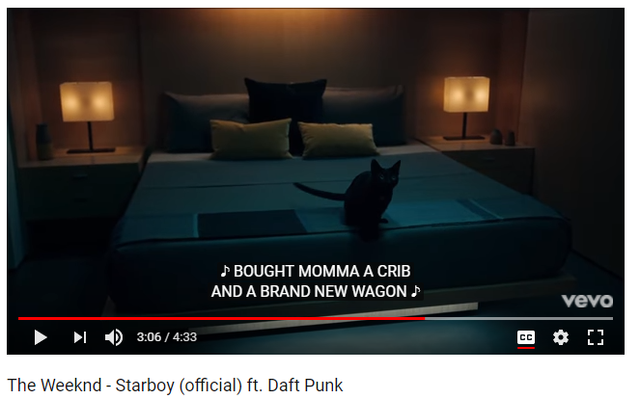
In this exercise we will examine song lyrics

Slide 5
But we will adjust the data format for joins
Tidy Form (Triplet, Dense Data)
Document Term Matrix
Document | Term | count
Tweet1 | Term2 | 1
Tweet1 | term3 | 1
Tweet2 | Term2 | 1
Tweet3 | Term… | 3
Tweet… | Term… | 1
Tweet… | Term_n | 1
Tweet_n | Term… | 1
 | Term1 | Term2 | Term3 | … | Term_n
Tweet1 | 0 | 1 | 1 | 0 | 0
Tweet2 | 0 | 1 | 0 | 0 | 0
Tweet3 | 0 | 0 | 0 | 3 | 0
… | 0 | 0 | 0 | 1 | 1
Tweet_n | 0 | 0 | 0 | 1 | 0
Sparse Data: Memory used to hold 0s
Dense Data: Efficient in Memory

Slide 6

And tidy programming uses the pipe operator…%>%

Slide 7
%>% just forward objects so don’t be intimidated
Tidytext is part of the tidy universe including ggplot and dplyr. Code is structured so it is more easily read using the %>%. The data format is a tibble and is in “tidy” format (long form).
mtcars %>% group_by(cyl) %>% mutate(rank = min_rank(desc(mpg)))
This reads as “Using the mtcars object then group by the cyl vector then mutate a new variable called rank.

Slide 8
Tidy can seem complicated but not impossible.
The pipe operator
%>%
Forwards an object so the code is easy to understand & concise.
all.sentiment <- all.tidy %>%
inner_join(nrc.lexicon) %>%
count(tweet,sentiment) %>%
spread(tweet, n, fill = 0)
Sentiment
words
Song text
inner_join()

Slide 9
Starting with a DTM, its straightforward
cleanTibbles <- list()
for(i in 1:length(all)){
x <- VCorpus(VectorSource(all[i])) #declare as a corpus
x <- cleanCorpus(x, customStopwords) #clean each corpus
x <- DocumentTermMatrix(x) #make a DTM
x <- tidy(x) #change orientation
x$document <- documentTopics[i]
cleanTibbles[[documentTopics[i]]] <- x #put it into the list
}
# Get bing lexicon
# "afinn", "bing", "nrc", "loughran"
bing<-get_sentiments(lexicon = c("bing"))
# Perform the join
bingSent <- inner_join(allText,
bing,
by=c('term'='word'))
DTM is from the “tm” library
Easy way to make it into a tibble.
Weeknd Lyrics
Bing Lexicon

Slide 10
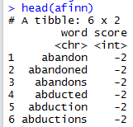
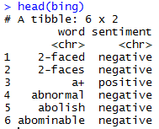
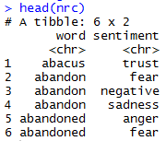
TidyText has other sentiment lexicons
Each can be used in an inner join to get different ways of assessing sentiment.
AFINN- Dutch researcher
Words scored -5 to 5
Bing- U of I-Chi Researcher
Words scored Pos/Neg
NRC – mTurk
Words classified into 8 primary & pos/neg
Weeknd Lyrics
Sentiment Lexicon

Slide 11
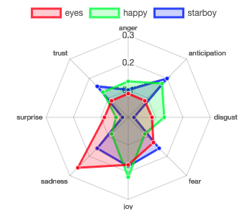
Remember Plutchik’s Wheel of emotion? Let’s mimic it!
The script drops positive & negative to focus on the explicit emotions.

Slide 12
Let’s practice sentiment analysis
Open 6_TidyText_Sentiment_revised.R
Open F_TidyText_Sentiment.R

